Slide 1

TOLLKEEPER.AI
an automated toll payment system
GROUP 08 | CSE499A.02

Slide 2
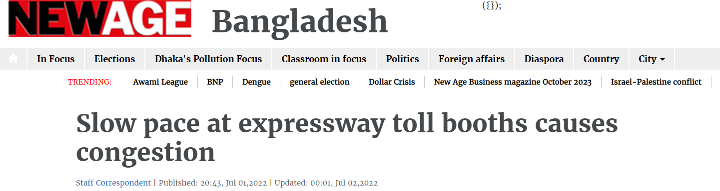
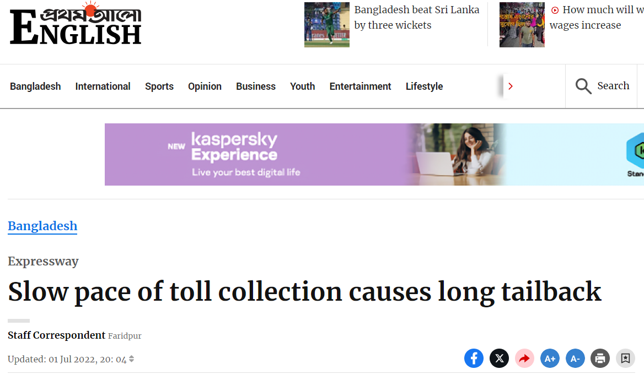
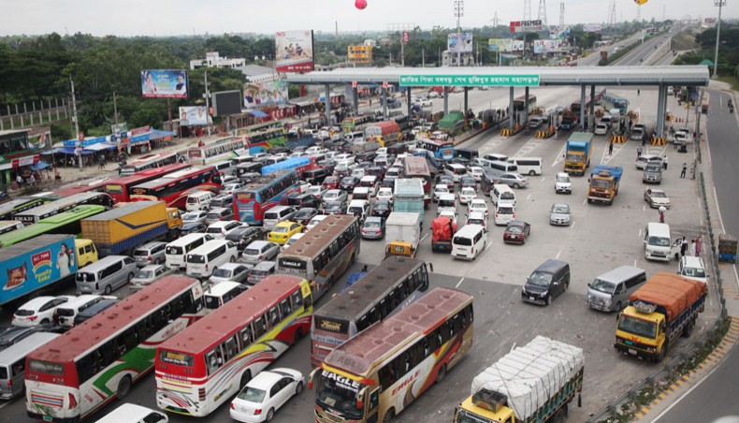
CURRENT
SCENARIO

Slide 3

TOLLKEEPER.AI
AUTOMATED TOLL PAYMENT SYSTEM
NO NEED TO STOP AT TOLL PLAZAS ANYMORE
PAY FROM ANYWHERE, ANYTIME
COLLAB WITH GOVT. (MINISTRY OF ROADS & HIGHWAYS)

Slide 4
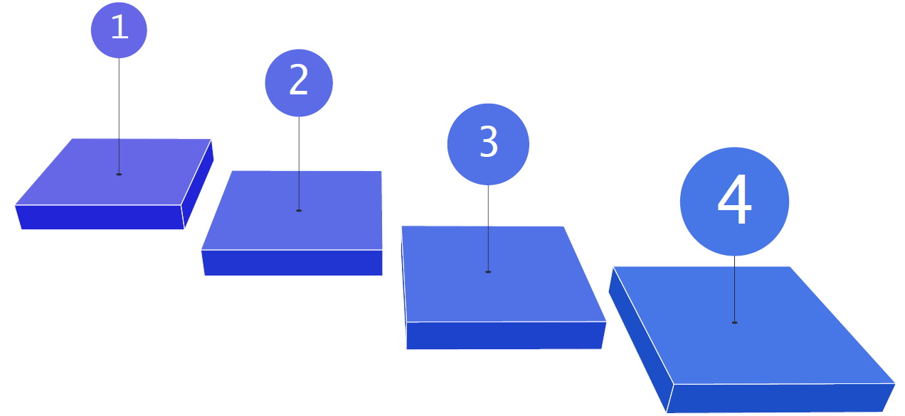
TASKS
DONE
AUGMENTATION
(clodsa)
VALIDATION
TRAIN AI MODEL
(YOLOv5)
GOOGLE COLAB

Slide 5
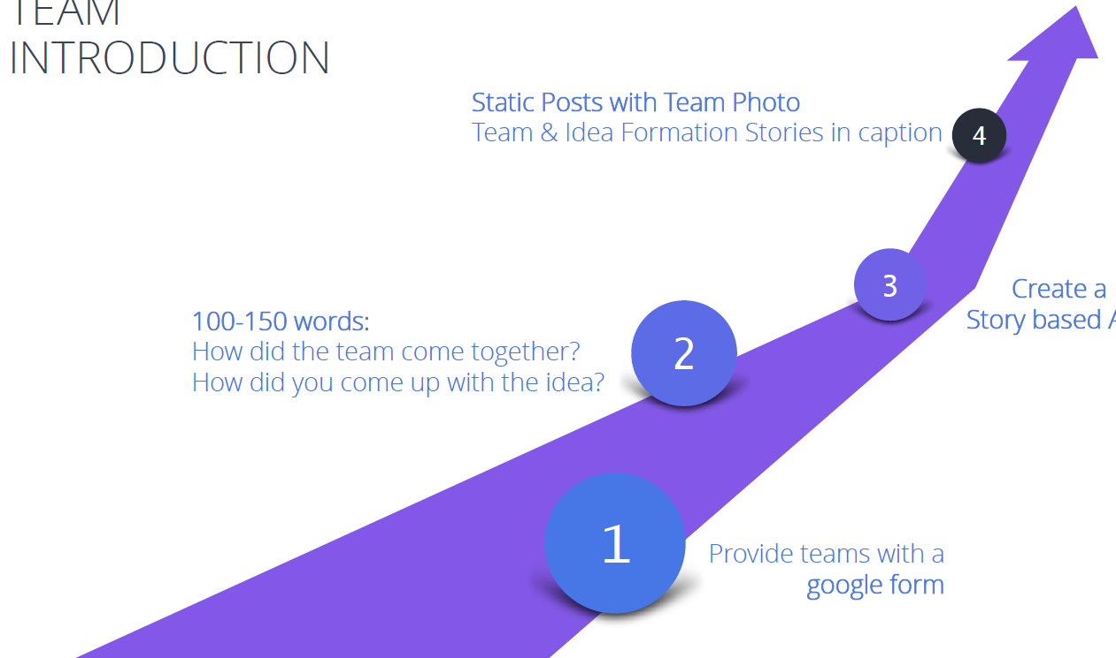
PROCEDURE
AUGMENTATION & VALIDATION
Augmentation of the dataset images through clodsa and completing validation subsequently

Slide 6
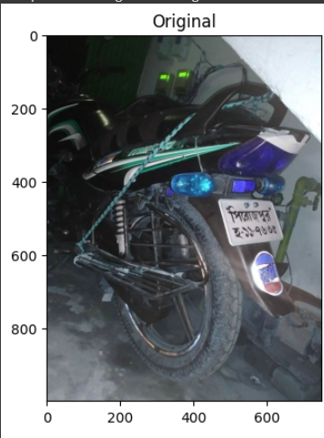
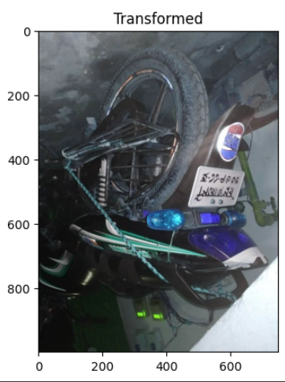
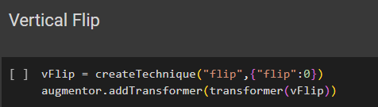
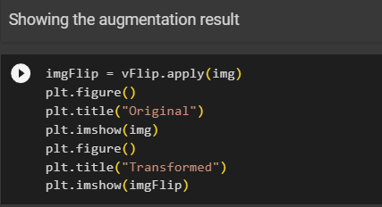
VERTICAL FLIP

Slide 7
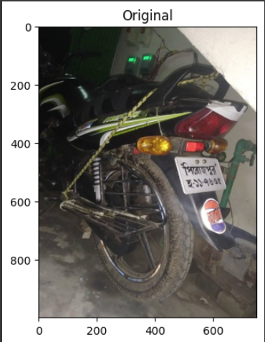
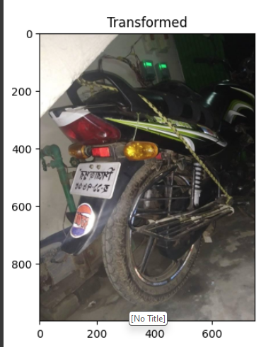
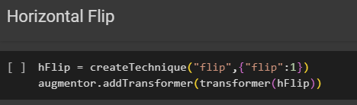
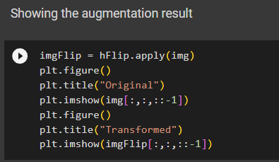
HORIZONTAL FLIP

Slide 8
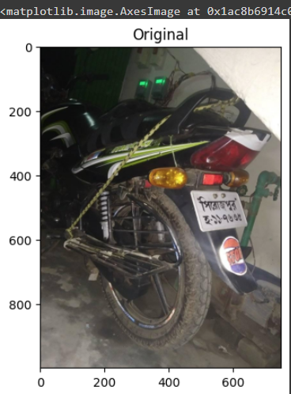
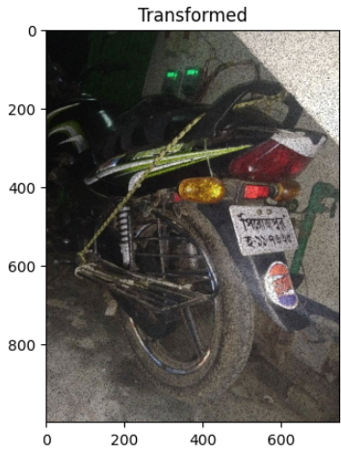
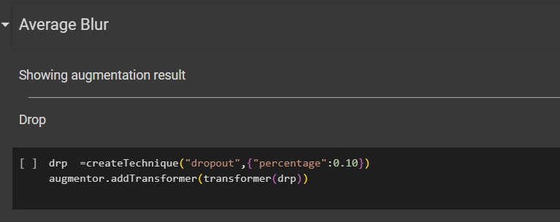
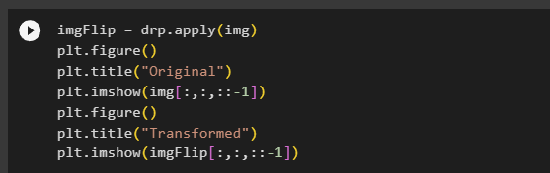
AVERAGE BLUR

Slide 9
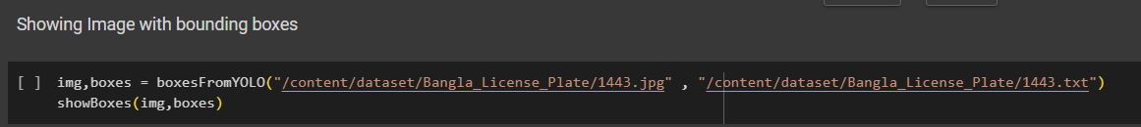
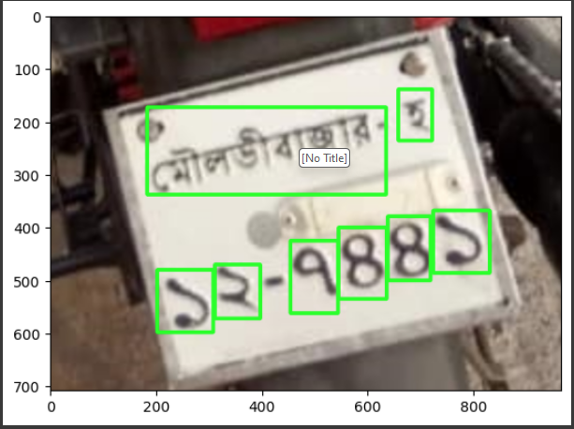
BOUNDING BOX

Slide 10
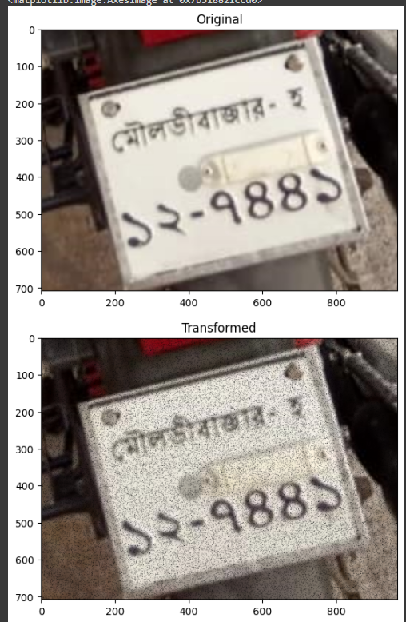
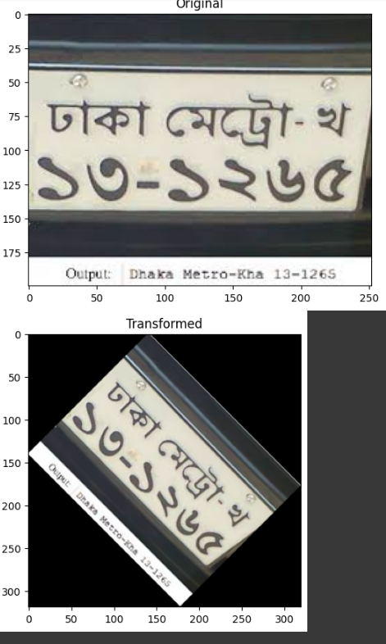
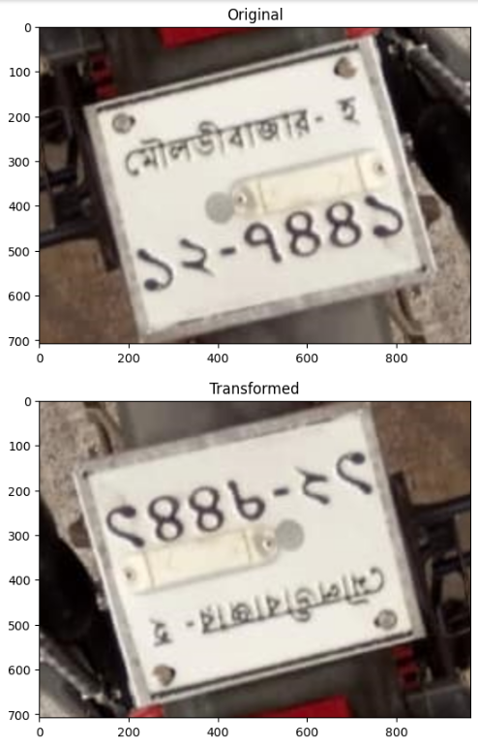
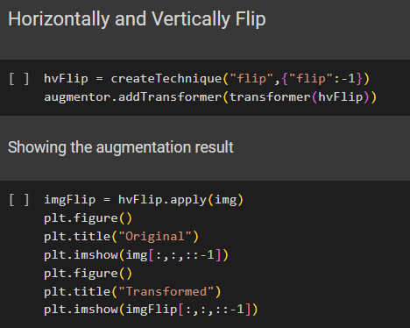
LICENCE PLATE
(FLIPS & BLUR)

Slide 11
PROCEDURE
DETECT
Recognize the number plate in the car by using detect.py
AUGMENTATION & VALIDATION
Augmentation of the dataset images through clodsa and completing validation subsequently

Slide 12
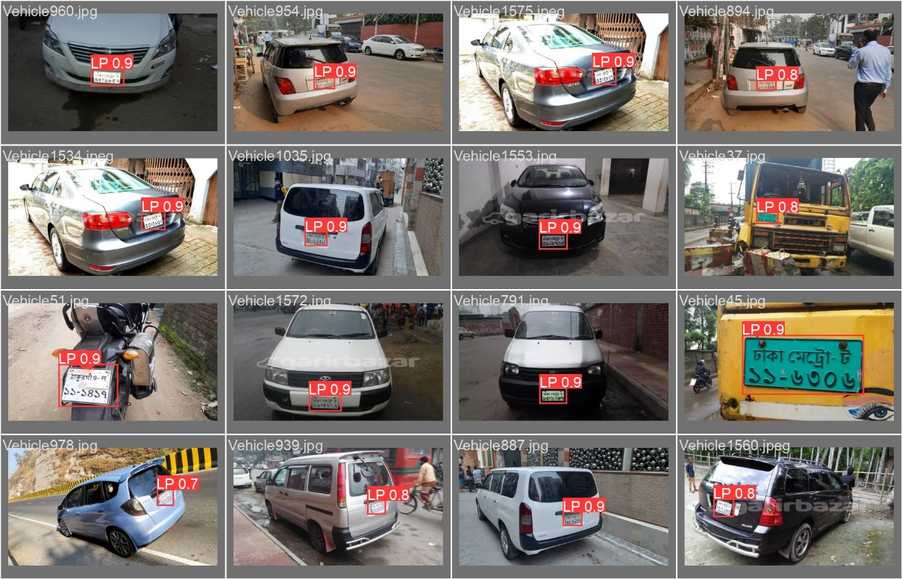
DETECTING THE NUMBER PLATE

Slide 13
PROCEDURE
CROP
Crop the number plate and process it for testing
DETECT
Recognize the number plate in the car by using detect.py
AUGMENTATION & VALIDATION
Augmentation of the dataset images through clodsa and completing validation subsequently

Slide 14
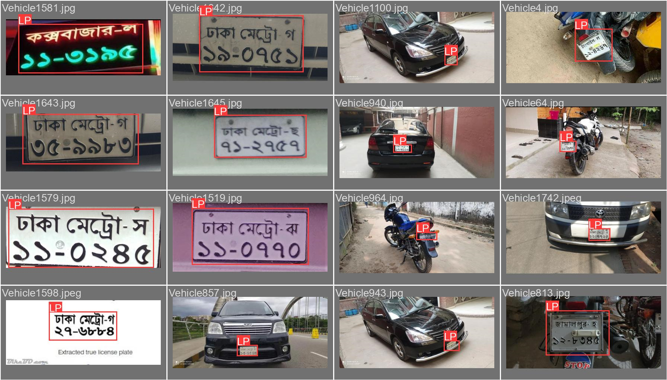
CROPPING THE NUMBER PLATE

Slide 15
PROCEDURE
READ & EXTRACT
Read the Bengali text using Bengali.traindata and extract the text using tesseract.ocr
CROP
Crop the number plate and process it for testing
DETECT
Recognize the number plate in the car by using detect.py
AUGMENTATION & VALIDATION
Augmentation of the dataset images through clodsa and completing validation subsequently

Slide 16
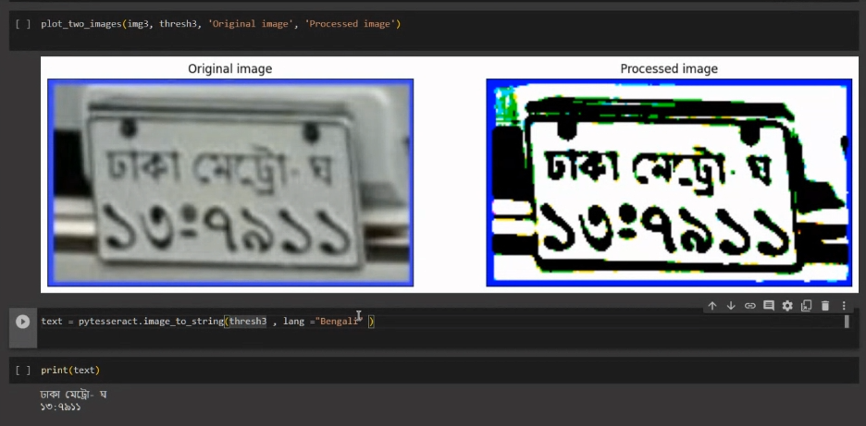
READING &
EXTRACTING

Slide 17

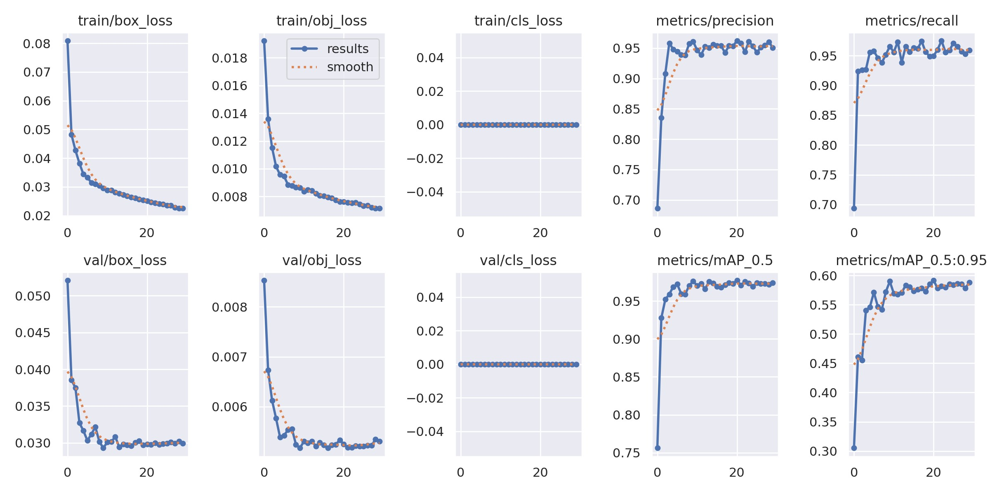
RESULTS
97.4%
We achieved 97.4% accuracy with map50;
Decreased the Loss and Increased the Precision

Slide 18
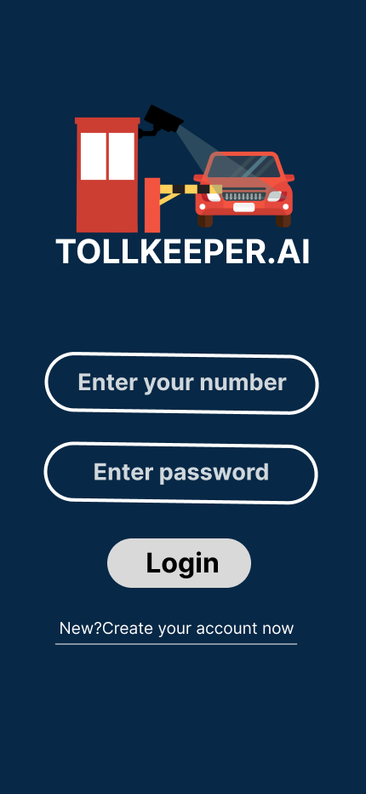
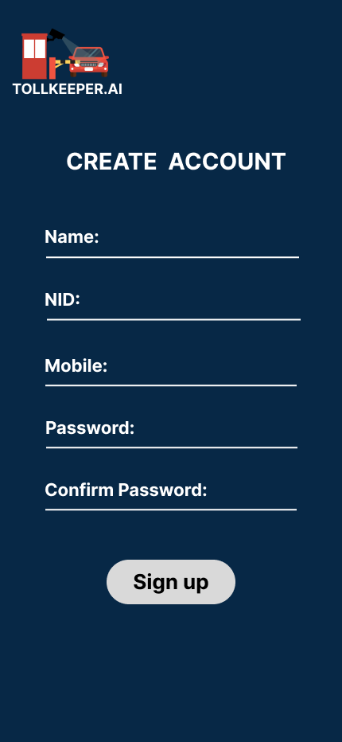
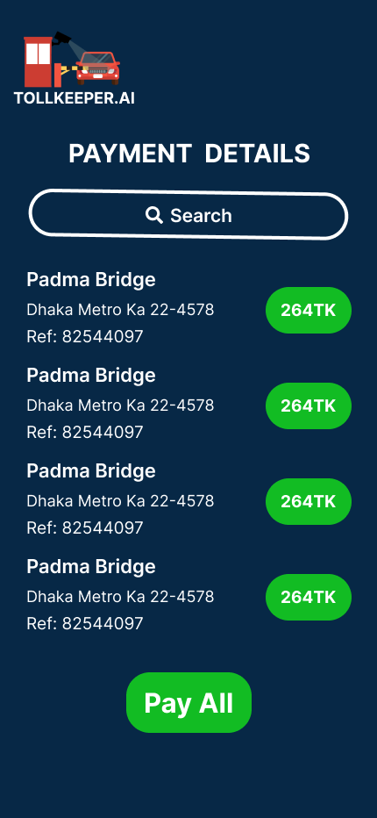
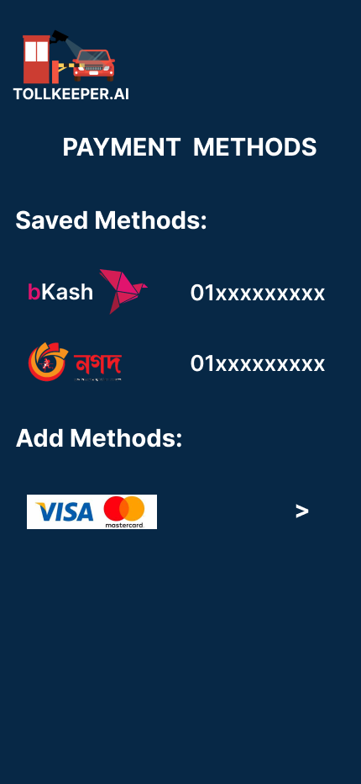
UX DESIGN

Slide 19
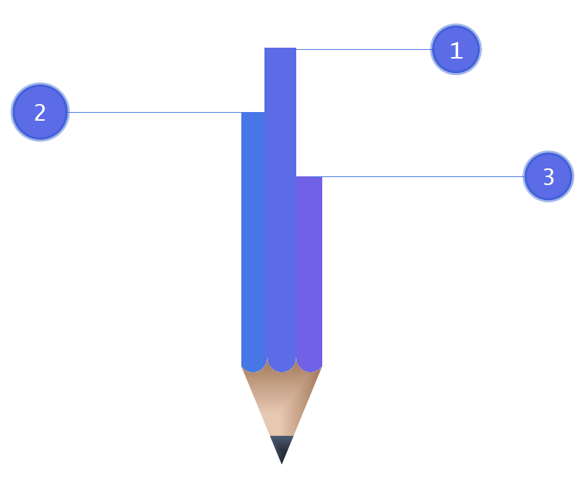
FUTURE
GOALS
PYTHON API
Connect it to the Python API and integrate it into the front-end
WEBSITE
Build a website for the admin side to control everything from the dashboard. Users can also access their part and pay the toll.
APP
Build an app for the users to pay the toll from any part of the nation within 3-5 working days

Slide 20

BUSINESS
PLANS
PARKING TRACKING SOFTWARE
partner up with shopping malls and commercial buildings (educational institutions and hospitals)
to install automated parking tracking software
TRAFFIC SURVEILLANCE
collab with city corporations and Police to install surveillance systems in cities
TOLL COLLECTION SYSTEM
collab with Bridges and Expressways to
gain toll collection contracts

